Slide 1
LICOR Project
Chile Team
Lily Northcutt

Slide 2
Outline
Goals and Motivation
Data: collection process, and description of out data sources
Possible Roadblocks/Risks and Mitigation
Project Task Outline/Progress Check

Slide 3
Goals and Motivation
Goal
Understand the relationship between the HPLC and porometry/fluorometry, which factors are most influential, and by how much.
We will do this by training a model to predict HPLC using the porometry/fluorometry data – all collected for 20 genotypes at Leyendecker and FG.
Motivation
Plant breeders and researchers want to understand the relationship between stress and HPLC in peppers because it will help them with breeding/growing peppers with SHU requirements.

Slide 4

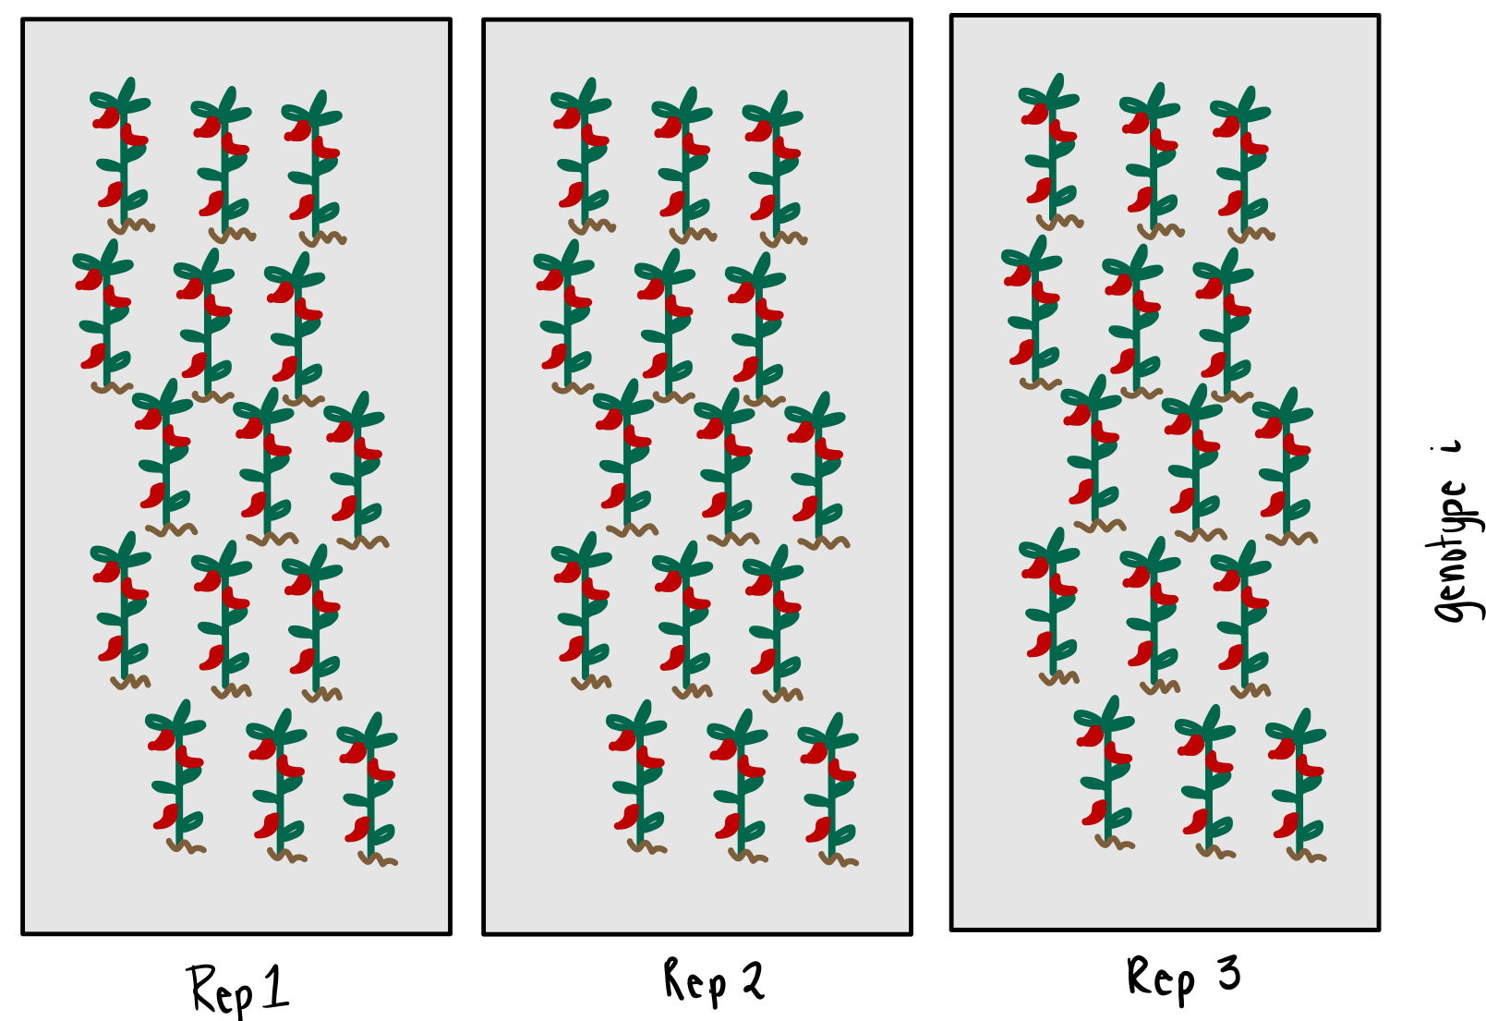
Data (1/2): Collection Process LICOR
FG – 3 readings / plant
Ley – 1 reading / plant
2. Five plants are sampled from each replication
3. Location dependent, n number of readings are taken from each sampled plant
1. Each genotype is planted in 3 replications

Slide 5
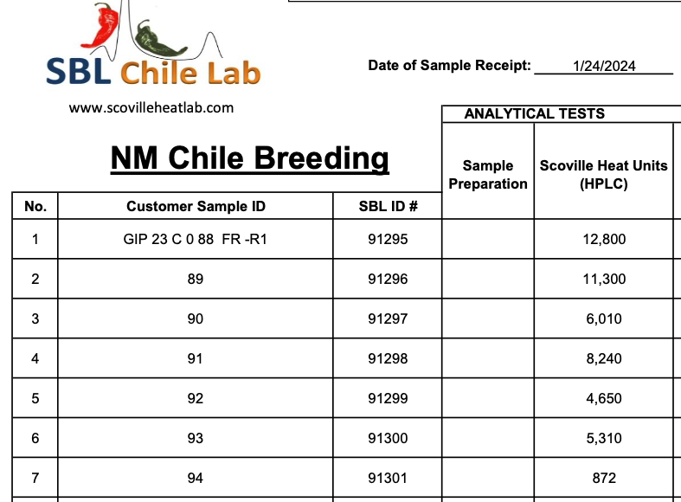
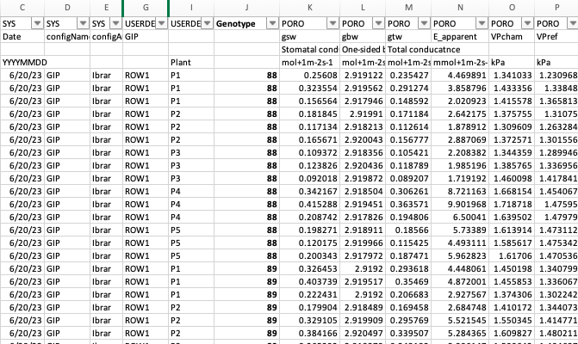
Data (2/2): Data Sources
1. HPLC Data
File 1: PDF with HPLC data for Leyendecker
File 2: PDF with HPLC data for FG
Note: 1 data point per GBS, i.e. all 15 plants in each replication (45 in total) were combined
2. Porometry/Fluorometry Data (LICOR)
File 3: FG readings (45 per genotype) taken on 9/4/23
File 4: Ley readings (15 per genotype) taken on 6/20/23
File 5: Ley readings (15 per genotype) taken on 9/7/23
Note: LICOR provides a data dictionary here

Slide 6
Roadblocks/Risks | Mitigation
Missing/incomplete data due to weather/accidents/disease/etc. | Avoided ! ☺
Collaboration Misunderstanding | - Define goals clearly, provide background - Lots of discussions about what we are seeing, next steps, and motivation - Sharing next steps throughout the duration of the project
Shareability/Accessibility of the Code and Analysis | - Clearly document all steps (reference, methodology, commenting code) - Create R Shiny app for interactive visuals without coding experience - Use git, maintain proper file structure - Walkthrough of code, make Rmarkdown file and detailed README
Code Not be Useable on New Data | - Define a data input structure that we think is ideal for analysis going forward, and keep this defined structure - Keep everything standardized (choose gbs 088 or 88)
Low Prediction Accuracy | - Feature analysis to understand which are highest contributors - Talk about lessons learned, and improve this season's collection - Create general pipeline for smooth and easy LICOR ingestion in R

Slide 7
Project Timeline
✔️
Data Collection and Information Gathering
1. Ingest:
- Read in the varying formats of the data, standardize dataset, and combine into clean structure
2. Clean/Wrangle:
- Check/handle missing data or incorrect (hplc <50), add labels (FG/Ley, location in row, etc.)
3. Visualize:
- Create interactive visuals to look at the cleaned data
Data Ingestion and Cleaning/Wrangling
Feature Engineering and Data Exploration
Training Models
Model Evaluation and Selection
Reevaluate and Retrain for improvement
Make predictions and share results

Slide 8
Project Status – March 25 II. Data Ingestion and Cleaning/Wrangling
Blocked
Understand HPLC Data Collection: Data collection process to generate HPLC? How much spread in SHU is expected for 1 genotype?
To Do
Read in LICOR data from all different formats
Clean LICOR Data
Add addition columns to LICOR and perform feature analysis
Combine LICOR with SHU and Visualize data
In Progress
Design interactive app to look at the data - Build interactive app interface - Graphs of SHU per genotype - Anomaly/outlier graphs
Completed
Setup GIT for project
Create excel file of HPLC data, add gbs/names, and then read into excel
Clean data: standardize column types, handle ”<“ , add shu labels
Plot hplc data, look for outliers/important behavior
Work with Ibrar and team to create standardized LICOR input for R Code

Slide 9
Project Status – April 8 II. Data Ingestion and Cleaning/Wrangling
Blocked
To Do
Read in harvest data
Add addition columns to LICOR and perform feature analysis
Combine LICOR with SHU and Visualize data
In Progress
Design interactive app to look at the data - Build interactive app interface - Graphs of SHU per genotype - Anomaly/outlier graphs
Clean LICOR Data
Completed
Read in LICOR data from all different formats
Work with Ibrar and team to create standardized LICOR input for R Code

